Slide 1
Group Members
Sajjad Akbar Khan, 2023634
M Saad, 2023498
M Safiullah, 2023337

Slide 2

Smart Campus Navigation System
This presentation explores the Smart Campus Navigation System, a comprehensive tool for managing and navigating campus infrastructure. The system leverages graph-based representation and linked lists to efficiently manage connections between buildings, offering functionalities like shortest path finding, graph traversals, and building isolation.

Slide 3
System Architecture
Edge Structure
LinkedList Class
CampusGraph Class
Represents a connection between two buildings. Contains destination building name, distance, and pointer to the next edge in the linked list.
Manages all edges for a building. Includes functions to add, display, delete, and remove edges, and returns the head pointer for traversal.
Represents the entire campus as a graph using an adjacency list implemented with the LinkedList class. Contains a map of buildings to their connections and a list of all buildings.

Slide 4
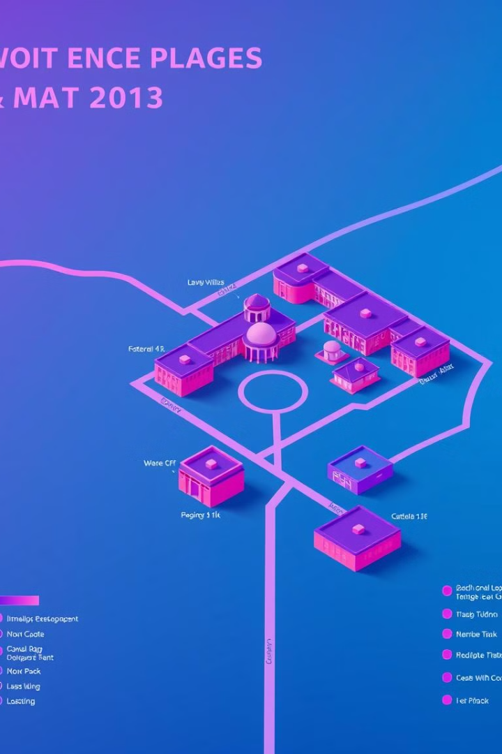
Features and Functionalities
1
Add Connection
2
Display Campus Map
Adds a bidirectional connection between two buildings with a specified distance. Updates the adjacency list to reflect the connection.
Displays each building and its connections in a readable format. Iterates through the adjacency list and prints all edges for each building.
3
Search Building
Checks whether a building exists in the campus graph. Returns a message indicating whether the building is found or not.

Slide 5

BFS Traversal
1
Algorithm
Uses a queue to manage traversal order. Starts from a given building, marks it as visited, and visits all unvisited neighbors level by level.
2
Example Output
BFS Traversal from building A: A, B, C, D.

Slide 6



Dijkstra's Shortest Path Algorithm
Algorithm
Initializes all distances as infinity, except the starting building (distance = 0). Uses a priority queue to expand the least costly path, updating the distance to each neighbor if a shorter path is found.
Example Output
Shortest path from A to D is 30 meters. Path: A -> B -> D.

Slide 7

Delete Building
Function
Example Output
Removes a building and all edges connected to it from the graph. Updates the adjacency list to ensure no residual connections remain.
Building 'A' and all its connections have been removed.

Slide 8
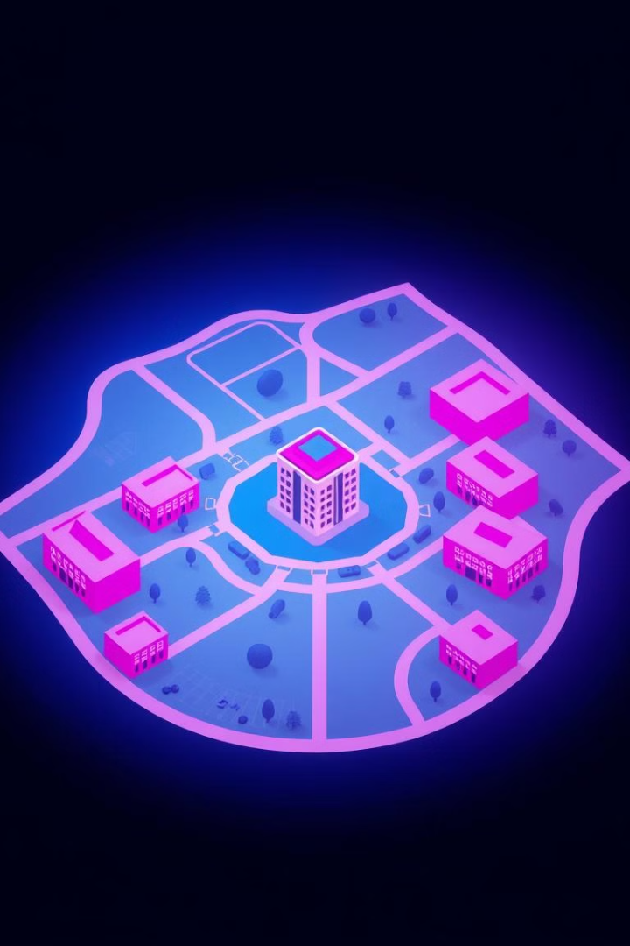

Display Isolated Buildings
Isolated Buildings
Identifies and lists all buildings with no connections in the adjacency list.

Slide 9
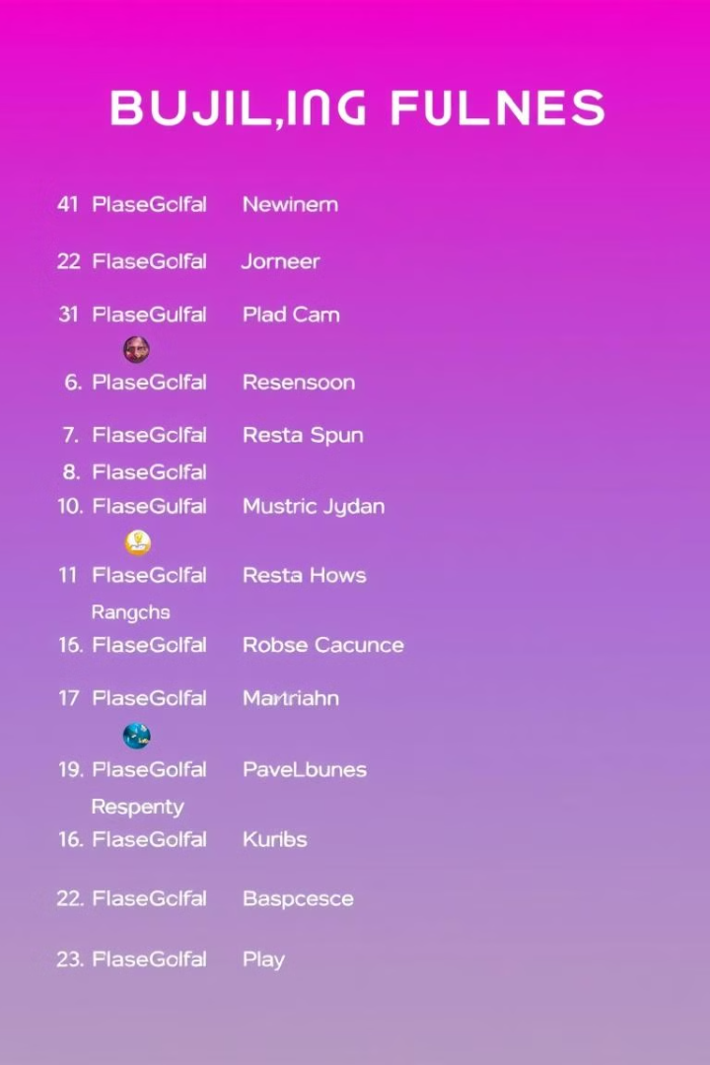
Sort Buildings Alphabetically
1
Sorted List
Sorts the list of buildings alphabetically and displays them.

Slide 10

Conclusion
The Smart Campus Navigation System provides a robust and efficient solution for managing and navigating campus infrastructure. Its graph-based representation and linked list implementation enable efficient data management and a wide range of functionalities, making it a valuable tool for campus administrators and students alike.

Slide 11

Next Steps
Future enhancements to the system could include the integration of real-time traffic data, user-friendly mobile app development, and the implementation of advanced pathfinding algorithms for more efficient route planning.

